Slide 1

Online Electronic Applications Database
Database Management System
Review 3
Submitted To:- Ramanathan L

Slide 2
Introduction
E-commerce is fast gaining ground as an accepted and used business paradigm. More and more business houses are implementing web sites providing functionality for performing commercial transactions over the web. It is reasonable to say that the process of shopping on the web is becoming commonplace.
The objective of this project is to develop a general purpose e-commerce store database where electronic products like mobile, computers can be bought.
An online store is a virtual store on the Internet where customers can browse the catalog and select products of interest. The selected items may be collected in a shopping cart. At checkout time, the items in the shopping cart will be presented as an order. At that time, more information will be needed to complete the transaction. Usually, the customer will be asked to fill or select a billing address, a shipping address, a shipping option, and payment information such as credit card number. An e-mail notification is sent to the customer as soon as the order is placed.

Slide 3
Project SCOPE
Online Electronic Application Store Database will do following processes
Any member can register and view available products
Only registered member can purchase multiple products regardless of quantity
There are three roles available: Visitor, User and Admin.
Visitor can view available products
User can view and purchase products.
An Admin has some extra privilege including all privilege of visitor and user. Admin can add products, edit product information and add/remove product.
Admin can add user, edit user information and can remove user.
The customer will be asked to fill or select a billing address, a shipping address, a shipping option, and payment information such as credit card number.
The bill will be given to the customer as soon as the order is placed.

Slide 4
Project Resource Requirements
Software Resource Requirements
Windows XP (Service Pack3),7,8,8.1 or 10
MySQL
Java JDK
Java JVM
JDBC Connector for my sql
Eclipse IDE for JAVA

Slide 5
Literature Survey

Slide 6
Factor Type | Individual Type | Surveyed studies | Major Finding
Demographics | Gender | [Alreck and Settle 2002; Brown et al. 2003; Donthu and Garcia 1999; Korgaonkar and Wolin 1999; Levy 1999; Li et al. 1999; ; Rodgers and Harris 2003; Slyke et al. 2002; Stafford et al. 2004] | Male consumers make more online purchases and spend more money online than females; they are equally or more likely to shop online in the future, and are equally or more favorable of online shopping. Women have a higher-level of web apprehensiveness and are more skeptical of e-business than men.
Demographics | Age | [Bellman et al. 1999; Bhatnagar and Ghose 2004b; Bhatnagar et al. 2000; Donthu and Garcia 1999; Joines et al. 2003; Korgaonkar and Wolin 1999; Li et al. 1999; Rohm and Swaminathan 2004; Stafford et al. 2004] | There are mixed findings on the relationship between age and online shopping intention.
Demographics | Income | [Bagchi and Mahmood 2004; Donthu and Garcia 1999; Korgaonkar and Wolin 1999; Li et al. 1999; Susskind 2004] | Income is positively related to online shopping tendency.

Slide 7
Demographics | Education | [Bagchi and Mahmood 2004; Bellman et al. 1999; Donthu and Garcia 1999; Li et al. 1999; Liao and Cheung 2001; Susskind 2004] | Education level produces mixed effects ranging from no effect to a positive effect on online shopping.
Demographics | Culture | [Chau et al. 2002; O'Keefe et al. 2000; Park and Jun 2003; Park et al. 2004; Shiu and Dawson 2002; Stafford et al. 2004] | Consumers from an individualistic culture are more likely to use the Internet for e-commerce than those from a collectivistic culture
Internet experience | WWW apprehensiveness (WA) | [Susskind 2004] | General WA is moderately related to WA relative to purchasing, and is negatively related to the amount of time spent online.
Internet experience | Frequency of Internet usage | [Bhatnagar and Ghose 2004b; Bhatnagar et al. 2000; Cho 2004; Citrin et al. 2000; Jarvenpaa and Todd 1997; Jarvenpaa and Tractinsky 1999; Liao and Cheung 2001; Nysveen and Pedersen 2004; Park 2002] | There are mixed results for the effects of Internet usage on online shopping intention. Internet usage is negatively related to perceived product risk.

Slide 8
Internet experience | Comfort with the Internet | [Mauldin and Arunachalam 2002] | Comfort level has a positive relationship with online shopping tendency.
Normative beliefs |  | [Foucault and Scheufele 2002; Limayem et al. 2000] | The influence of friends, family, and media recommendations on the tendency for online shopping is mixed
Shopping orientation |  | [Donthu and Garcia 1999; Korgaonkar and Wolin 1999; Li et al. 1999; Swaminathan et al. 1999] | Online consumers tend to be convenience-oriented, and recreational and economic shoppers appear to become dominant recently. Consumers’ proclivity to purchase products online is not found to vary across different online shopping orientations
Shopping motivation |  | [Childers et al. 2001; Joines et al. 2003; Johnson et al. 2004; Novak et al. 2000; Solomon 1999; Wolfinbarger and Gilly 2001] | Motivational factors play a key role in determining time spent on product searching and online shopping. Experiential (hedonic) shoppers always find more enjoyment in interactive environments than in pure text environments.
Personal traits | Innovativeness | [Citrin et al. 2000; Donthu and Garcia 1999; Goldsmith 2001; Goldsmith 2002; Limayem et al. 2000; Sin and Tse 2002] | Personal innovativeness has both direct and indirect effects on online shopping intention, the indirect effects being mediated by attitude.

Slide 9
Online experience | Online experience | [Huang 2003; Lynch and Beck 2001; Wolfinbarger and Gilly 2001; Xia 2002] | Positive emotions have positive influence on online shopping intention in some countries
Online experience | Flow | [Hoffman and Novak 1996; Mathwick and Rigdon 2004; Novak et al. 2000] | There are mixed results on the influences of flow on positive subjective experience and greater exploratory behavior
Psychological perception | Benefit perception | [Chen et al. 2002; Limayem et al. 2000; Pavlou 2003] | Perceived usefulness is positively related to the intention to purchase online.
Psychological perception | WWW purchasing apprehensiveness | [Susskind 2004] | WWW purchasing apprehensivenss is negatively related to the amount of money
Online Shopping experience | Frequency of online purchases | [Brown et al. 2003; Cho 2004; Foucault and Scheufele 2002; Moe and Pader 2004; Park and Jun 2003; Yang and Lester 2004] | Frequency of purchases is positively related to online shopping tendency and negatively related to the likelihood to abort an online transaction.
Online Shopping experience | Satisfactory levels about past online transactions | [Cho 2004; Devaraj et al. 2002; Foucault and Scheufele 2002; Koivumi 2001; Pires et al. 2004] | Previous satisfaction has a positive relationship with online shopping tendency.

Slide 10
Electronic Commerce (e-commerce) applications support the interaction between different parties participating in a commerce transaction via the network, as well as the management of the data involved in the process.
The increasing importance of e-commerce is apparent in the study conducted by researches at the GVU (Graphics, Visualization, and Usability) Center at the Georgia Institute of Technology. In their summary of the findings from the eighth survey, the researchers report that “e-commerce is taking off both in terms of the number of users shopping as well as the total amount people are spending via Internet based transactions”.
Over three quarters of the 10,000 respondents report having purchased items online. The most cited reason for using the web for personal shopping was convenience (65%), followed by availability of vendor information (60%), no pressure form sales person (55%) and saving time (53%).
Although the issue of security remains the primary reason why more people do not purchase items online, the GVA survey also indicates that faith in the security of ecommerce is increasing. As more people gain confidence in current encryption technologies, more and more users can be expected to frequently purchase items online . A good e-commerce site should present the following factors to the customers for better usability

Slide 11
• Returning to different parts of the site after adding an item to the shopping cart.
• Easy selecting items in a list.
• Effective categorical organization of products.
• Consistent layout of product information.
Knowing when an item was saved or not saved in the shopping cart.
Web site feedback often consists of a change in the visual or verbal information presented to the user. Simple examples include highlighting a selection made by the user or filling a field on a form based on a user's selection from a pull down list. Another example is using the sound of a cash register to confirm that a product has been added to an electronic shopping cart.
Completed orders should be acknowledged quickly. The amount of time it takes to generate and download this page, however, is a source of irritation for many e-commerce users. Users are quick to attribute meaning to events. A blank page, or what a user perceives to be "a long time" to receive an acknowledgment, may be interpreted as "there must be something wrong with the order." If generating an acknowledgment may take longer than what may be reasonably expected by the user, then the design should include intermediate feedback to the user indicating the progress being made toward acknowledgment or fulfillment.
Finally, feedback should not distract the user. Actions and reactions made by the web site should be meaningful. Feedback should not draw the user's attention away from the important tasks of gathering information, selecting products, and placing orders.

Slide 12
Tables and Constraints
User
SNO | NAME | TYPE | DESCRIPTION
1 | User_Id | Varchar | Foreign Key
2 | Password | Varchar

Slide 13
Customer
S NO | NAME | TYPE | DESCRIPTION
1 | Username | Varchar | Primary Key
2 | Password | Varchar | Security
3 | First_Name | Varchar
4 | Last_Name | Varchar
5 | Address | Varchar
6 | City | Varchar
7 | Zip | Integer
8 | Email_Address | Varchar
9 | Mobile Number | Varchar

Slide 14
Electronic Item
SNO | NAME | TYPE | DESCRIPTION
1 | Item_No | Varchar | Primary Key
2 | Item_Name | Varchar
3 | Company | Varchar
4 | No of Items | Integer
5 | Price | Double
6 | Type | Varchar
7 | Type_No | Varchar

Slide 15
Shopping_Cart_Items
S_NO | Name | Type | Description
1 | username | Varchar | Primary Key
2 | Item_No | Varchar
3 | Price | Double
4 | Quantity | Integer

Slide 16
Credit Card Details
SNO | NAME | TYPE | DESCRIPTION
1 | Credit Username | Varchar | Primary Key
2 | Credit Card Number | Varchar
3 | Card Type | Varchar | Master card , Visa
4 | Password | Varchar
5 | Expiry Date | Date
6 | Amount | Long int | Foreign Key

Slide 17
ER DIAGRAM

Slide 18
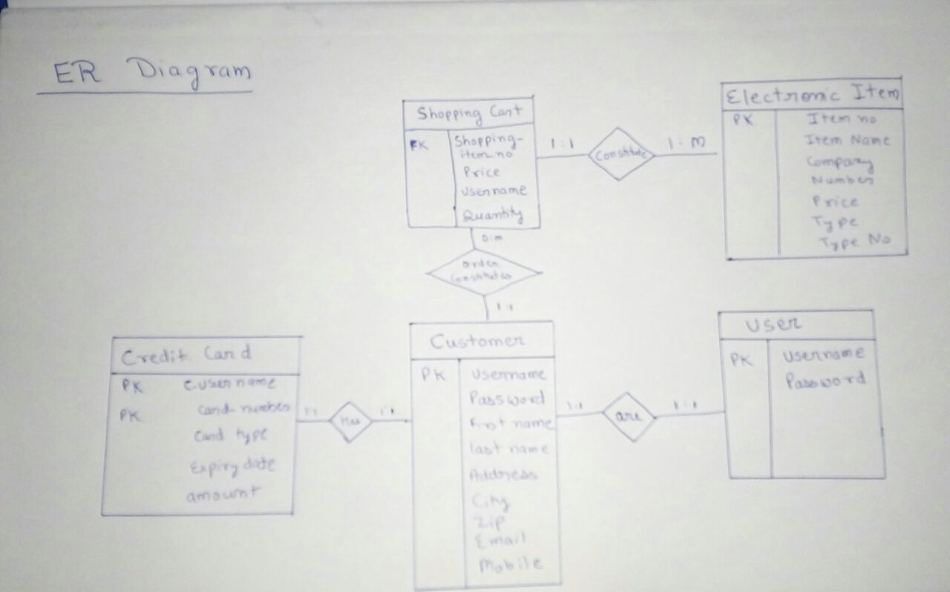

Slide 19
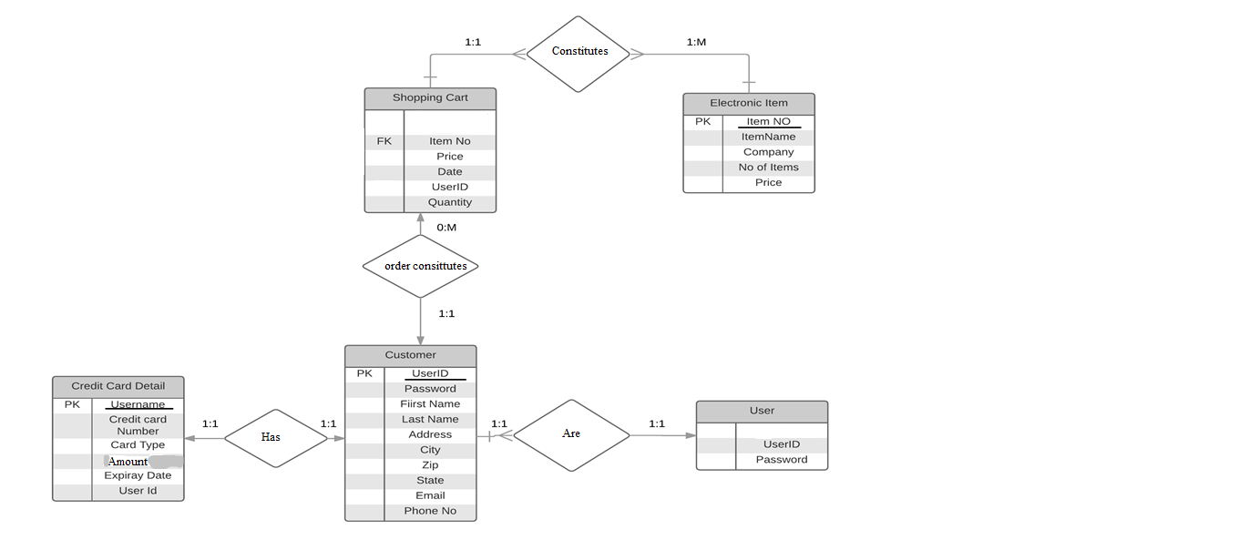
ER DIAGRAM

Slide 20
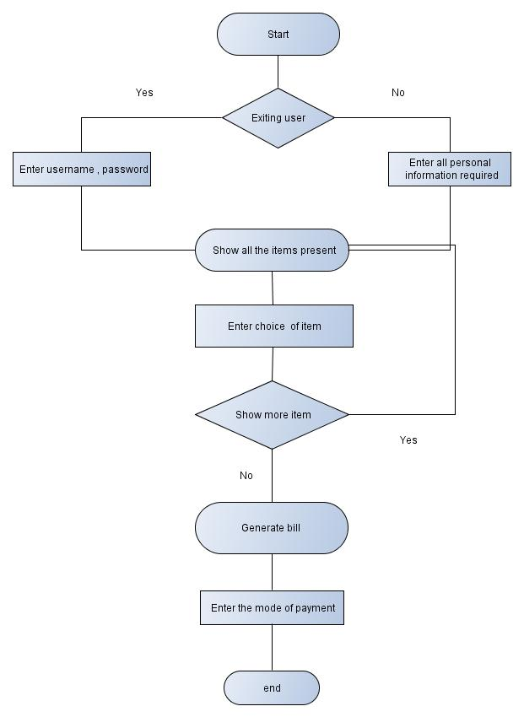
Flowchart for process

Slide 21
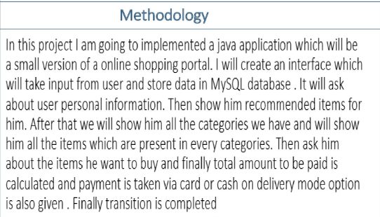

Slide 22
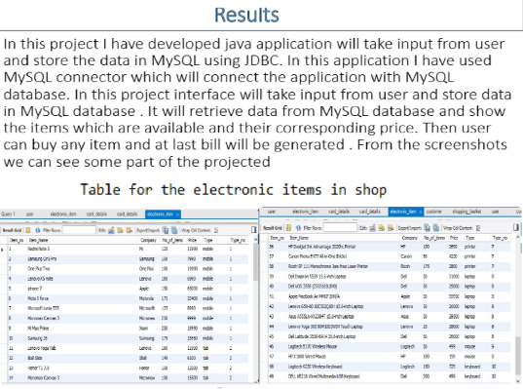

Slide 23
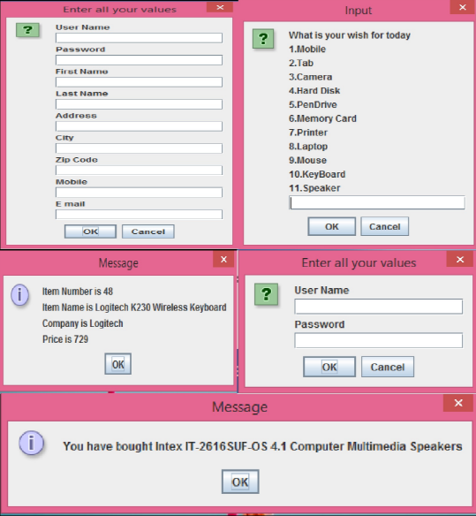
Some Screenshot

Slide 24
